Slide 1
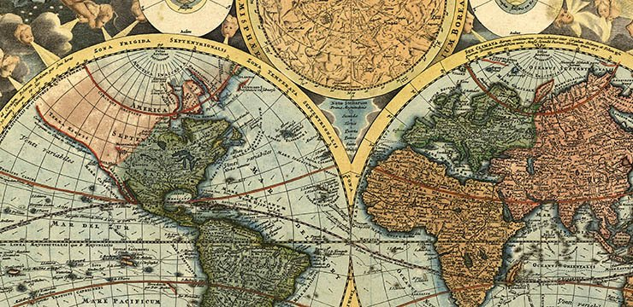
Kurzpräsentation Iteration 0
3. Wiki-Historybook
Simon Flühmann, Michael Sidler, Yulia Schmitt, Yan Zheng, Nicolas Zehnder, Silvio Pirozzi

Slide 2
Ablauf
Goals of the project
Overall project plan
Way of working
Progress during the last iteration
Main results
Goals and plans for the next iteration
Output from the retrospective
Problems / questions

Slide 3
Goals of the project
Finding the world’s leaders through the ages through Wikipedia social networks
Wikipedia-Daten über die letzten 4‘000 Jahre
App mit openGL zur Visualisierung
Zeitleiste mit Slider mit den wichtigsten Personen
10 Jahresschritte mit Netzwerk
Priorisierung im Netzwerk

Slide 4
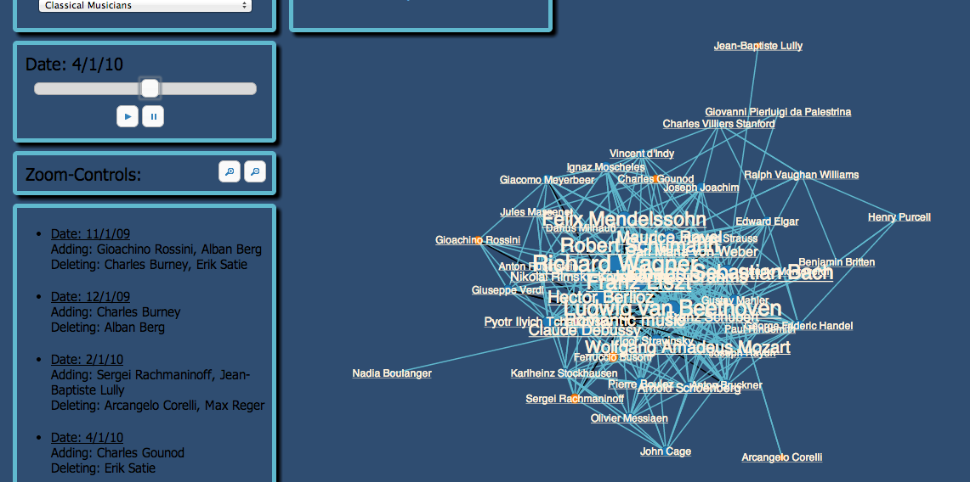
Example

Slide 5
Project Plan
Iteration 0: Project setup 14. April - 27. April → Teamformation, Project Overview
Iteration 1: Design 28. April - 4. Mai → Virtual Status Meeting
Iteration 2: 1st Prototyp 5. Mai - 18. Mai → Virtual Status Meeting
Iteration 3: 2nd Prototyp 19. Mai - 25. Mai → Virtual Mirror
Iteration 4: Draft solution 26. Mai - 1. Juni → Virtual Status Meeting
Iteration 5: Final solution 2. Juni - 16. Juni → Virtual Status Meeting, Final Presentation

Slide 6
Our way of working
Weekly meeting over google hangout
Collaboration via git repository
Scrum – Sprints = 1 Week
Lean scrum – eg. no daily standups..

Slide 7
Progress during last iteration
Get to know each other
Team setup
Setup of work & collaboration
Define project scope

Slide 8
Main results
Get to know each other (as far as possible)
Roles
Evalution of techniques
Technical decision
Rough Project plan
Github repository

Slide 9
Goals for the next iteration
Product Backlog, prioritized
Further definition
Design prototype
First software architecture design

